Slide 1
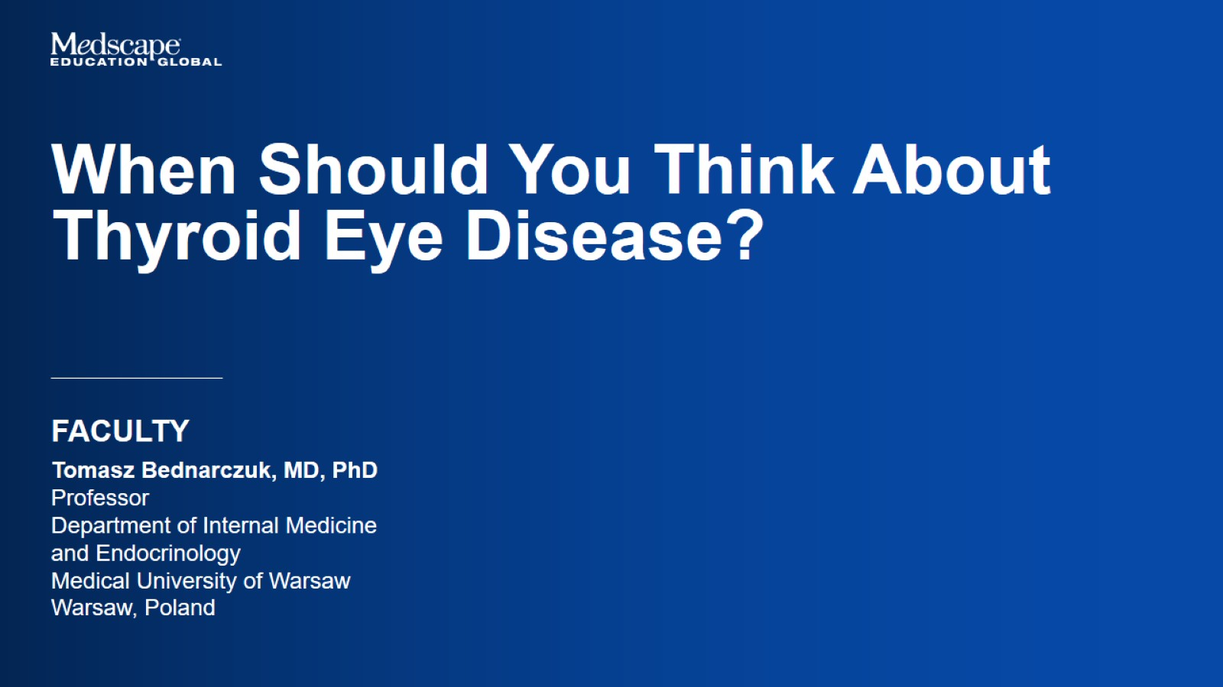

Slide 2
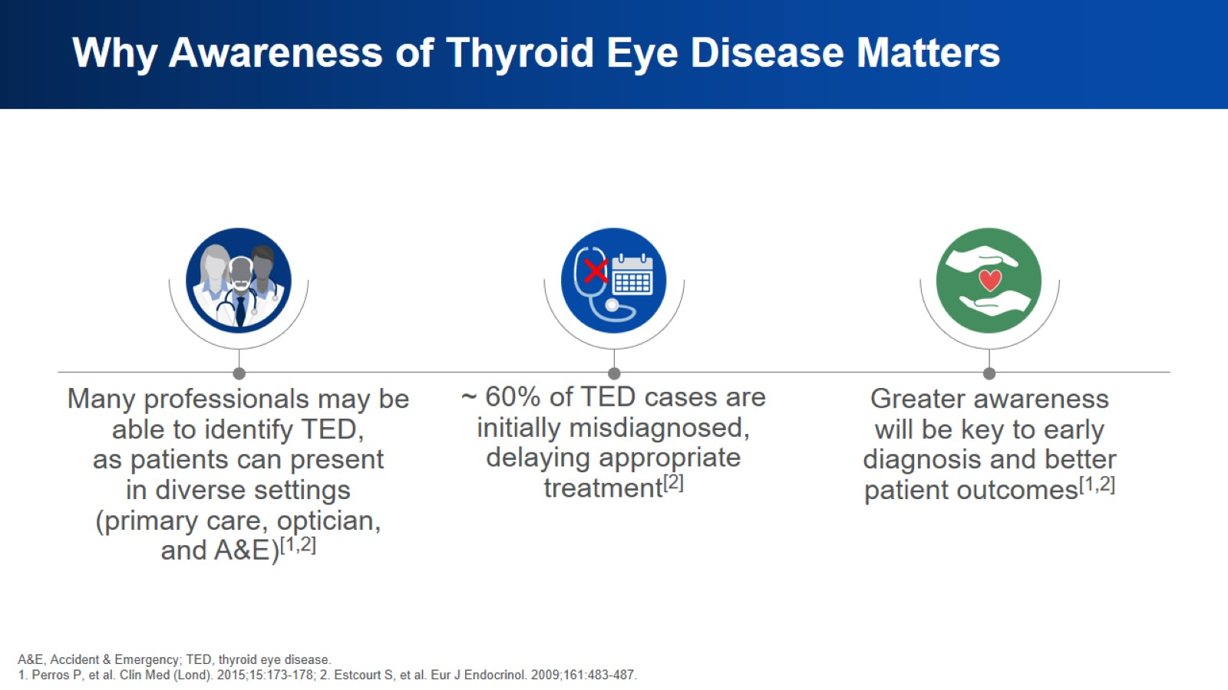
Why Awareness of Thyroid Eye Disease Matters

Slide 3
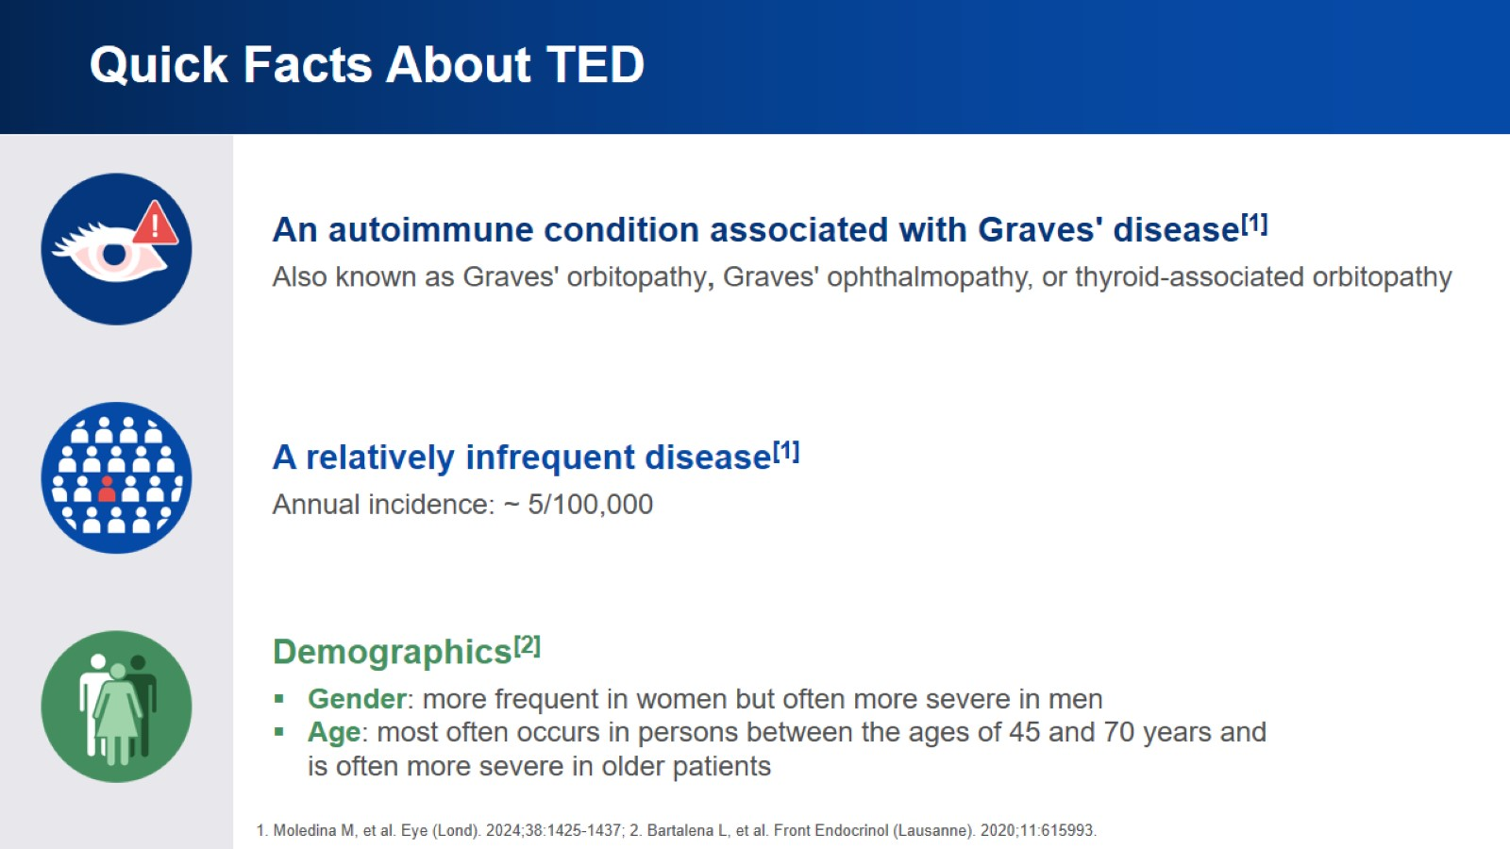
Quick Facts About TED

Slide 4
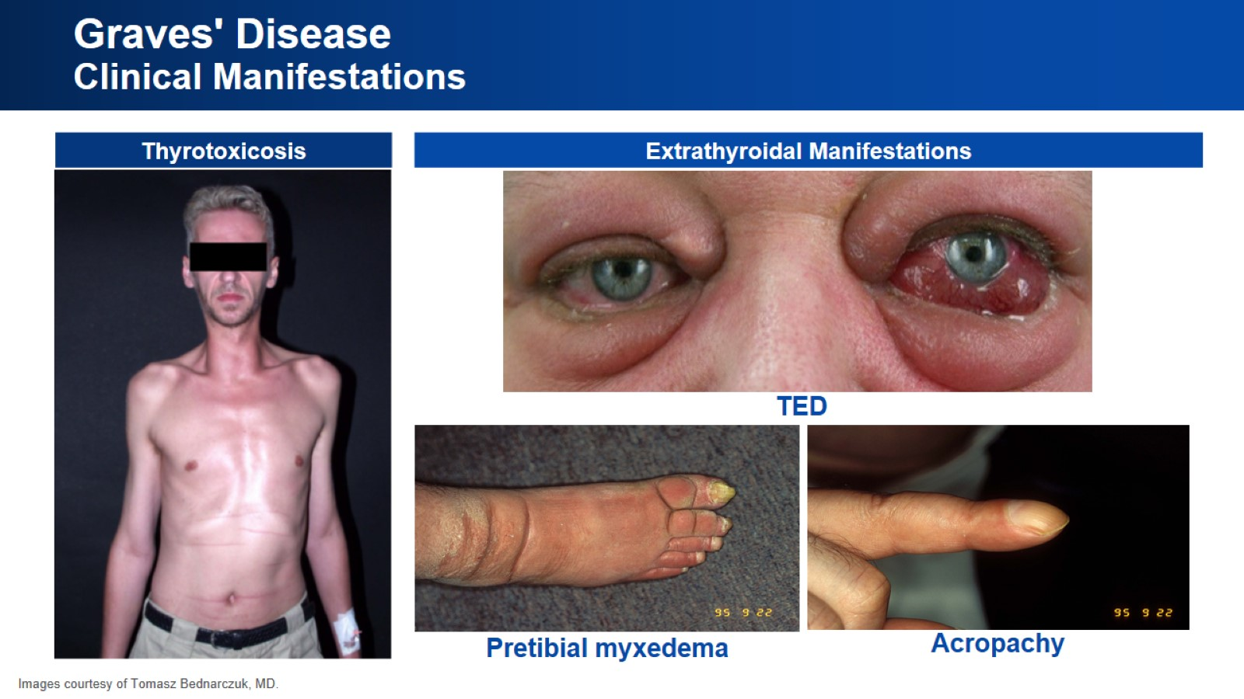
Graves' Disease
Clinical Manifestations

Slide 5
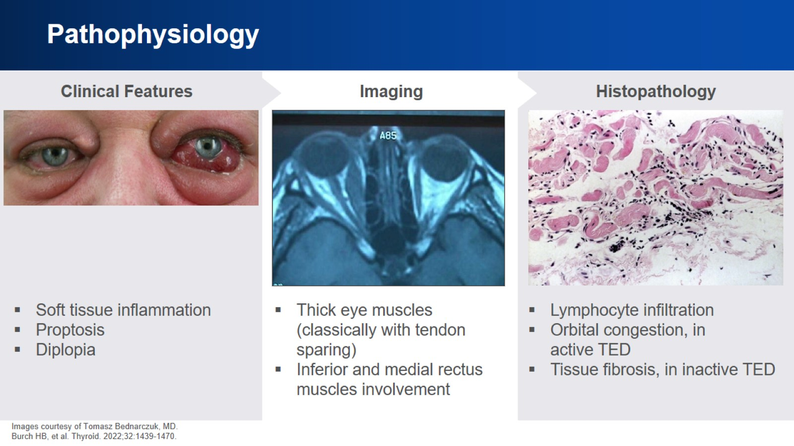
Pathophysiology

Slide 6
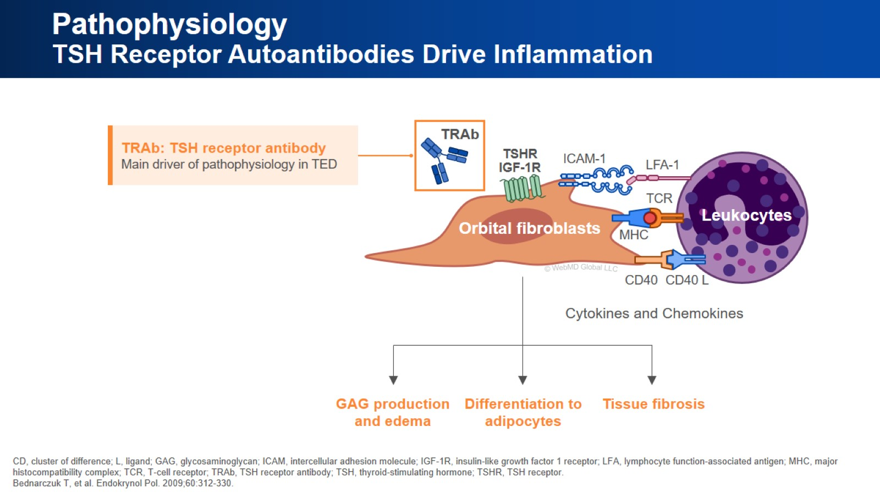
Pathophysiology
TSH Receptor Autoantibodies Drive Inflammation

Slide 7
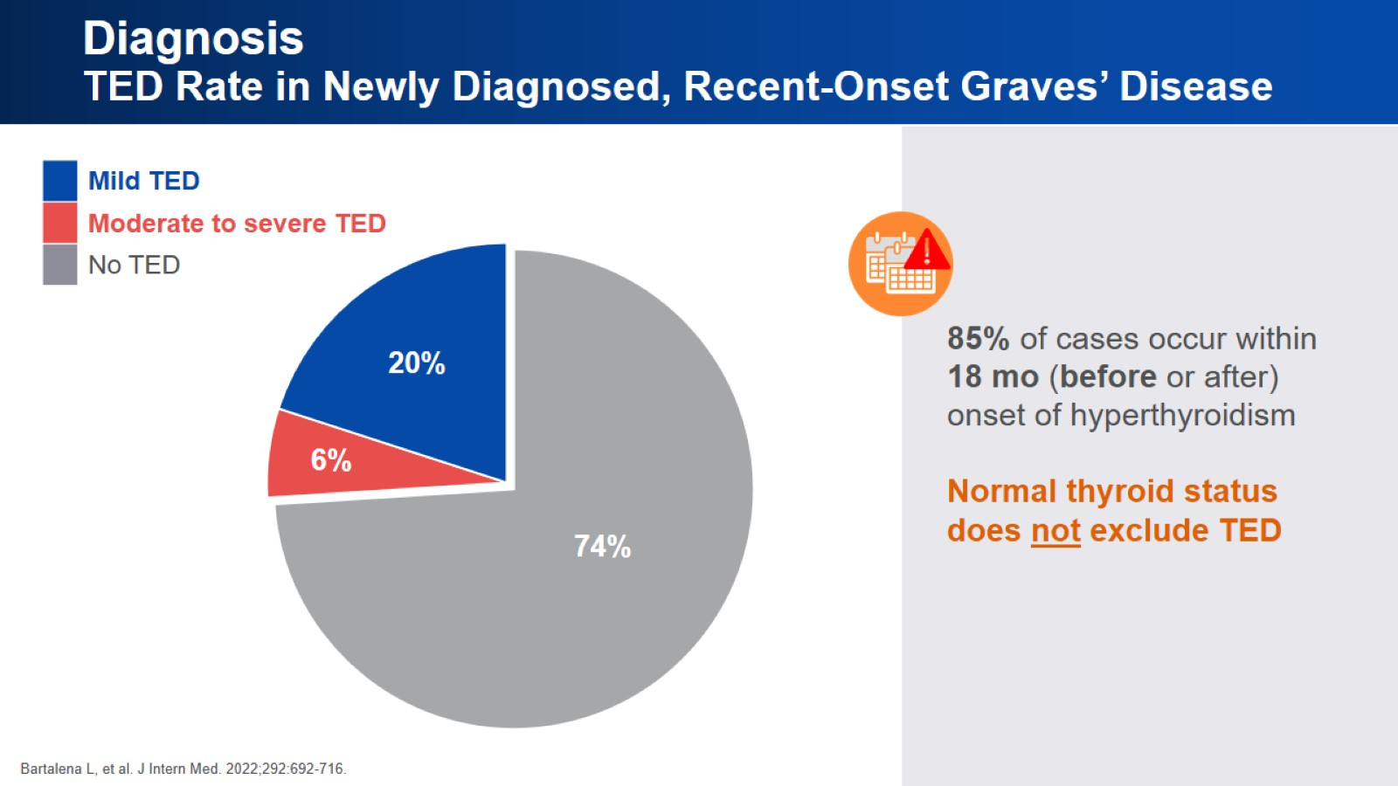
Diagnosis
TED Rate in Newly Diagnosed, Recent-Onset Graves’ Disease

Slide 8
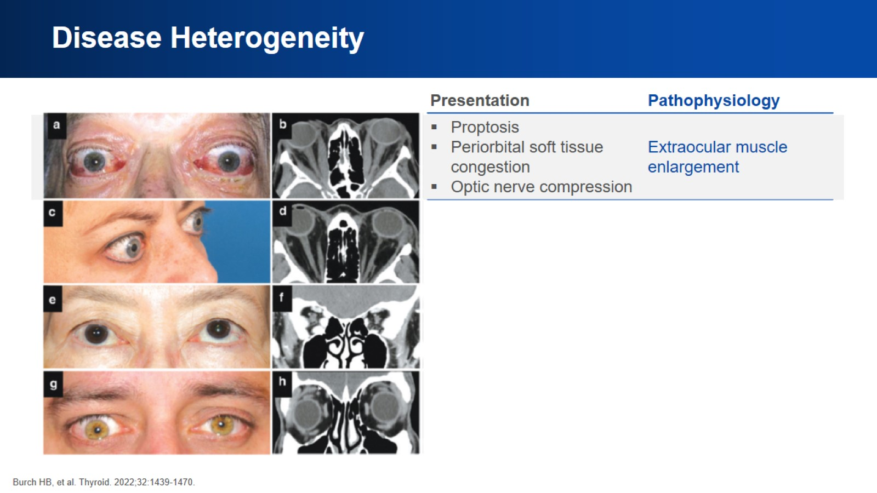
Disease Heterogeneity

Slide 9
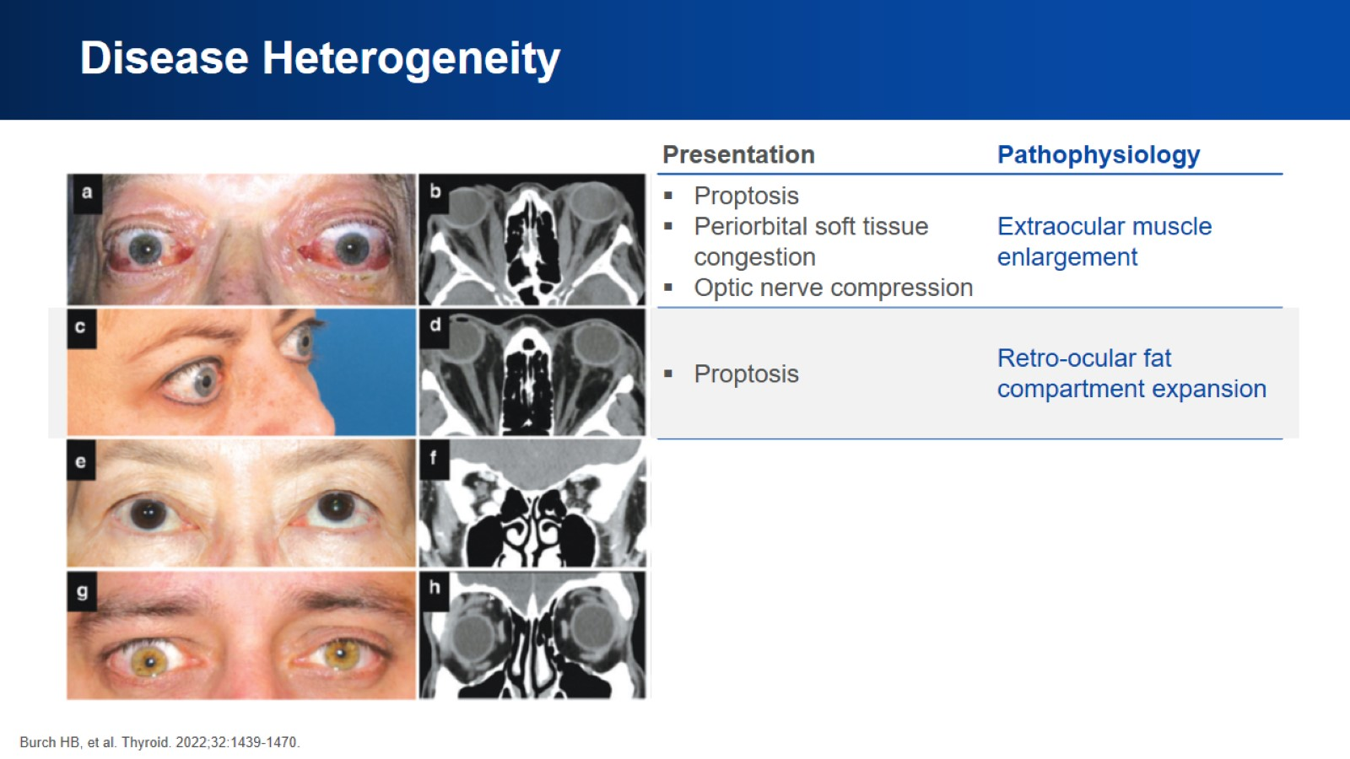
Disease Heterogeneity

Slide 10
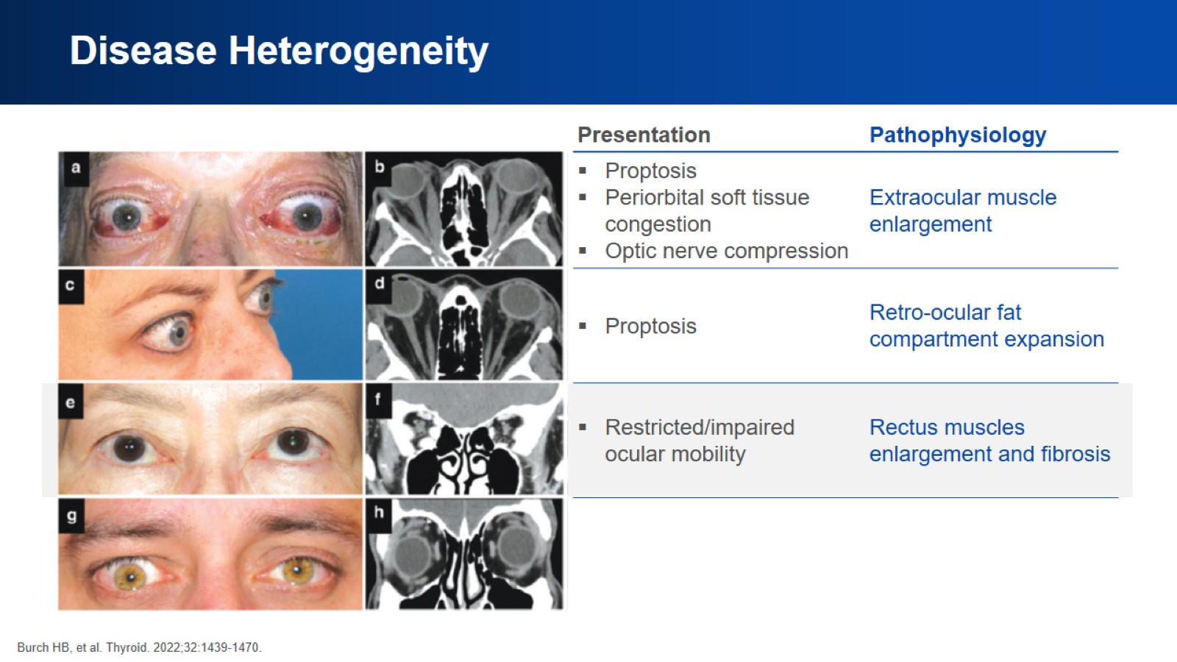
Disease Heterogeneity

Slide 11
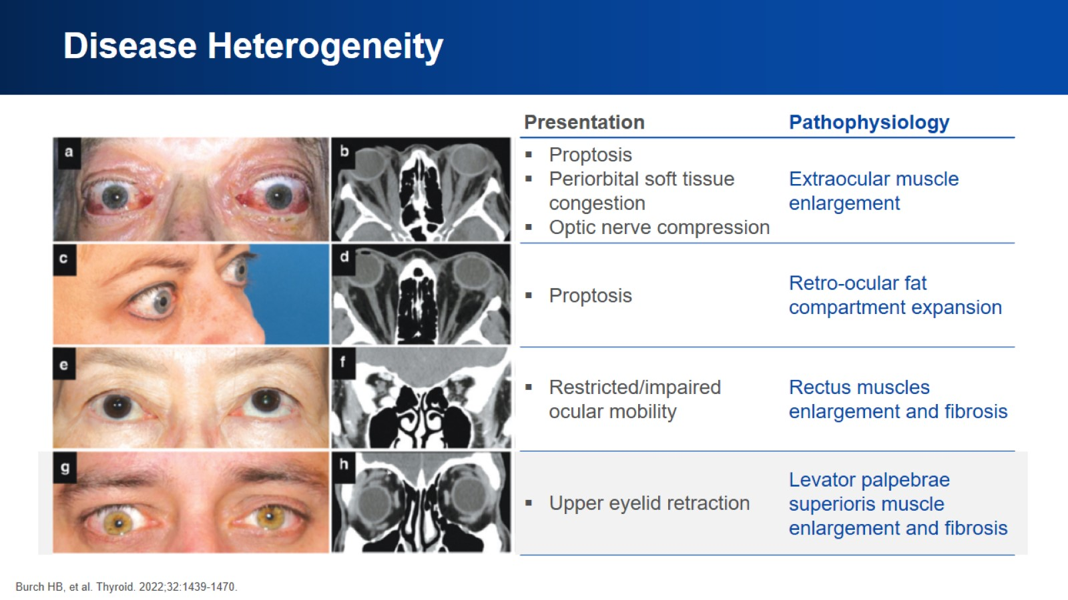
Disease Heterogeneity

Slide 12
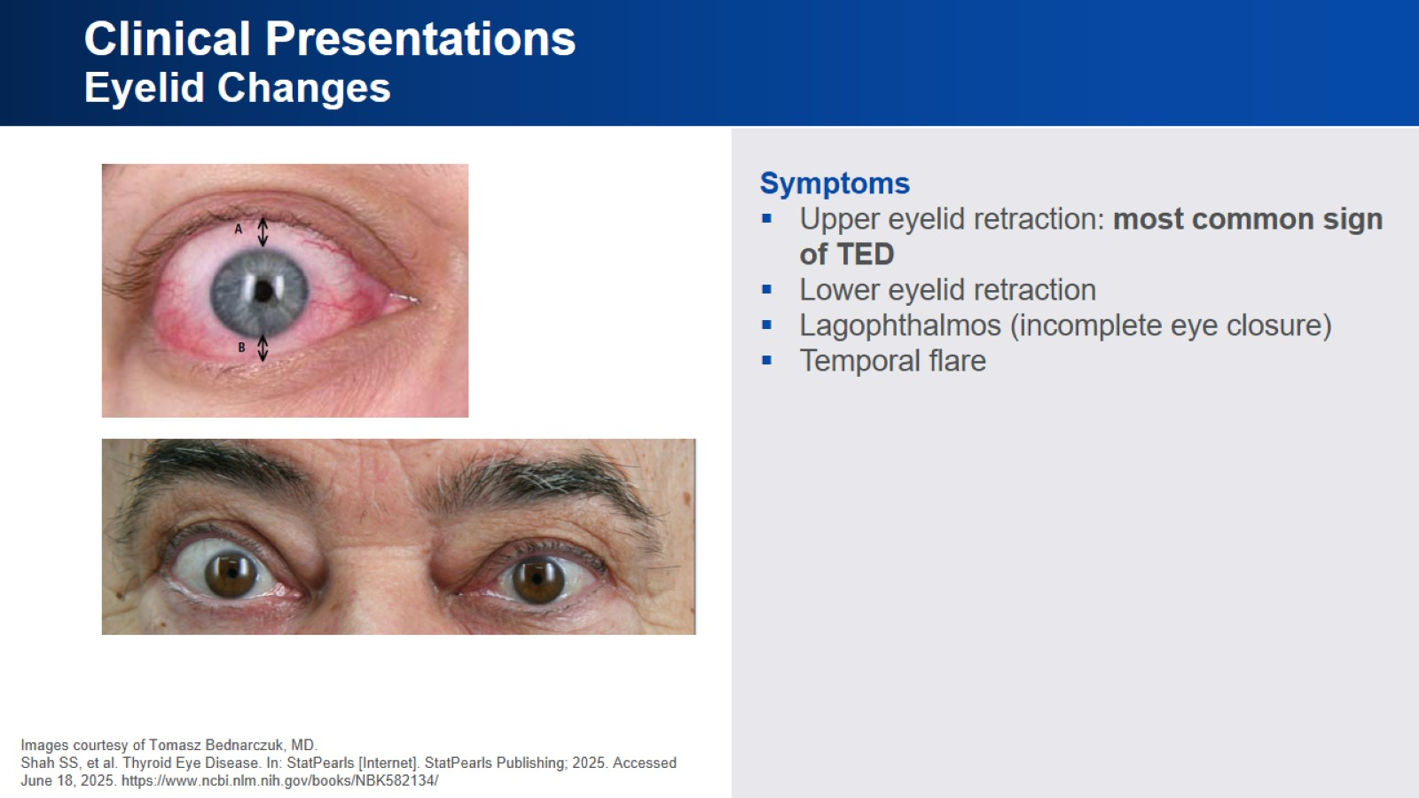
Clinical Presentations
Eyelid Changes

Slide 13
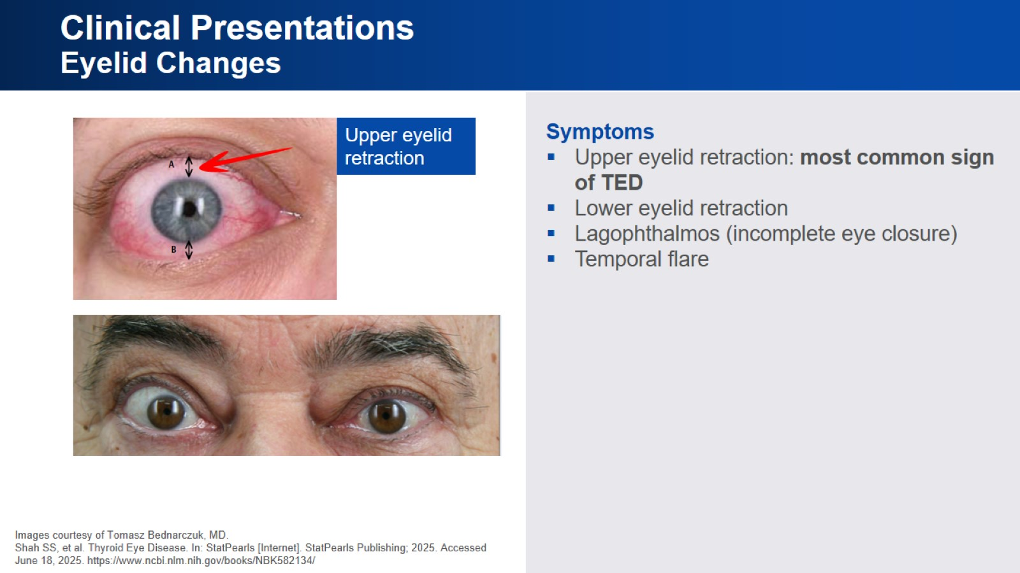
Clinical Presentations
Eyelid Changes

Slide 14
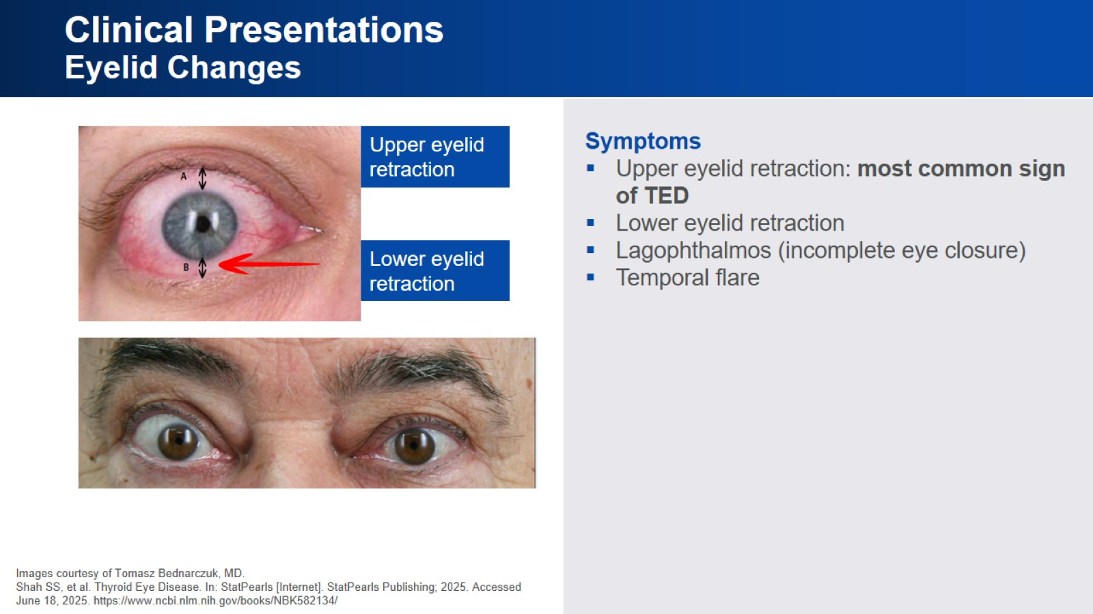
Clinical Presentations
Eyelid Changes

Slide 15
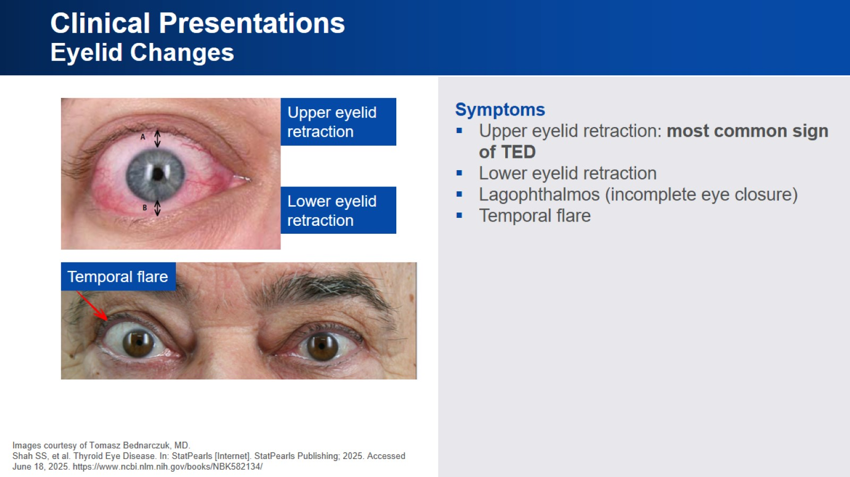
Clinical Presentations
Eyelid Changes

Slide 16
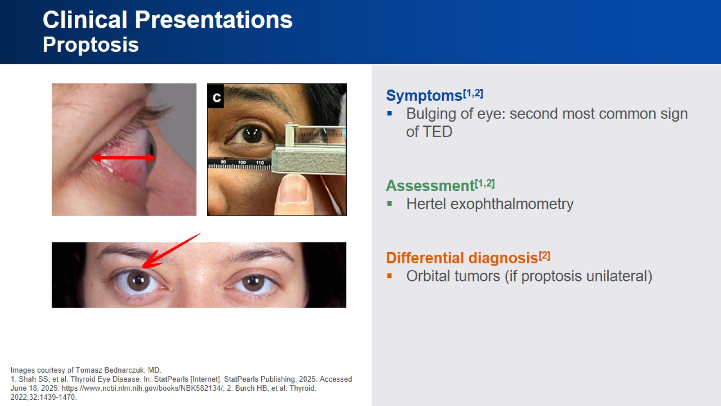
Clinical Presentations
Proptosis

Slide 17
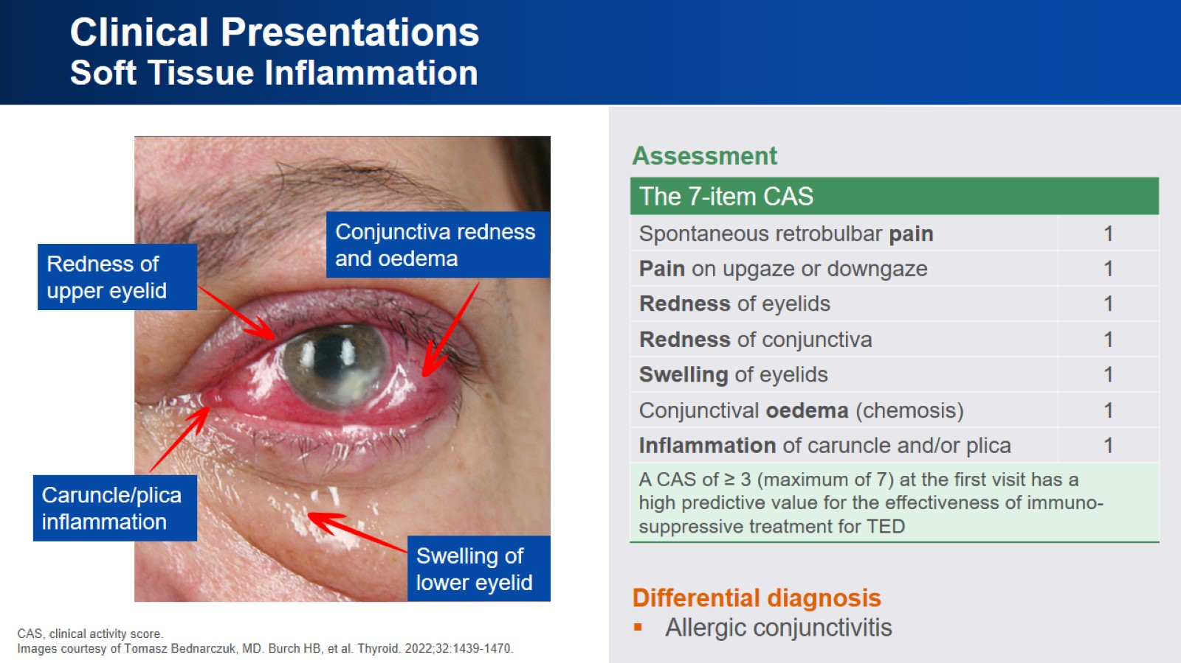
Clinical Presentations
Soft Tissue Inflammation

Slide 18
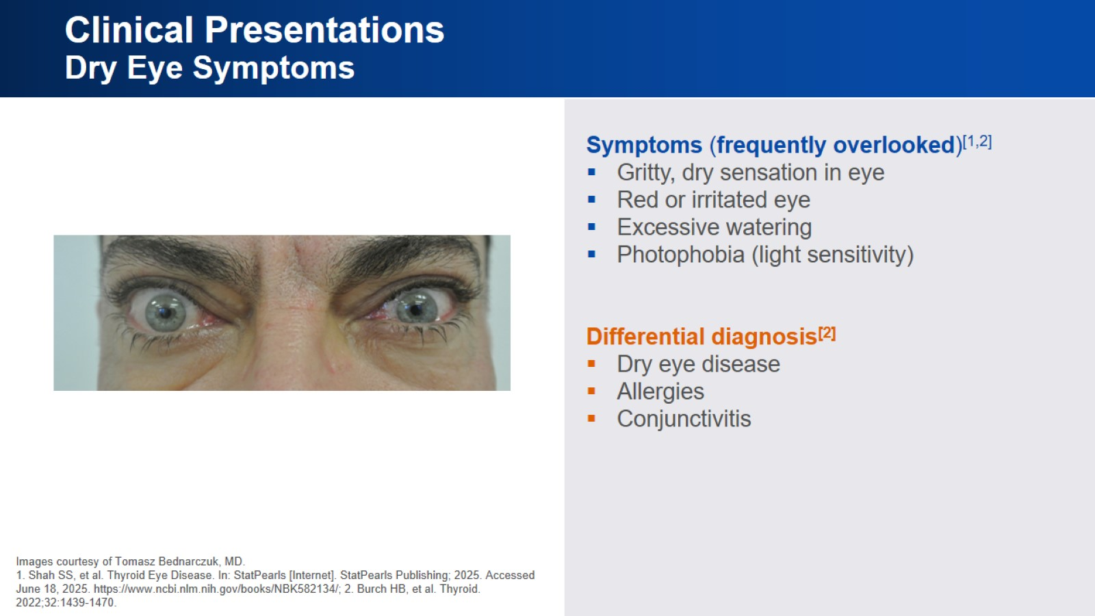
Clinical Presentations
Dry Eye Symptoms

Slide 19
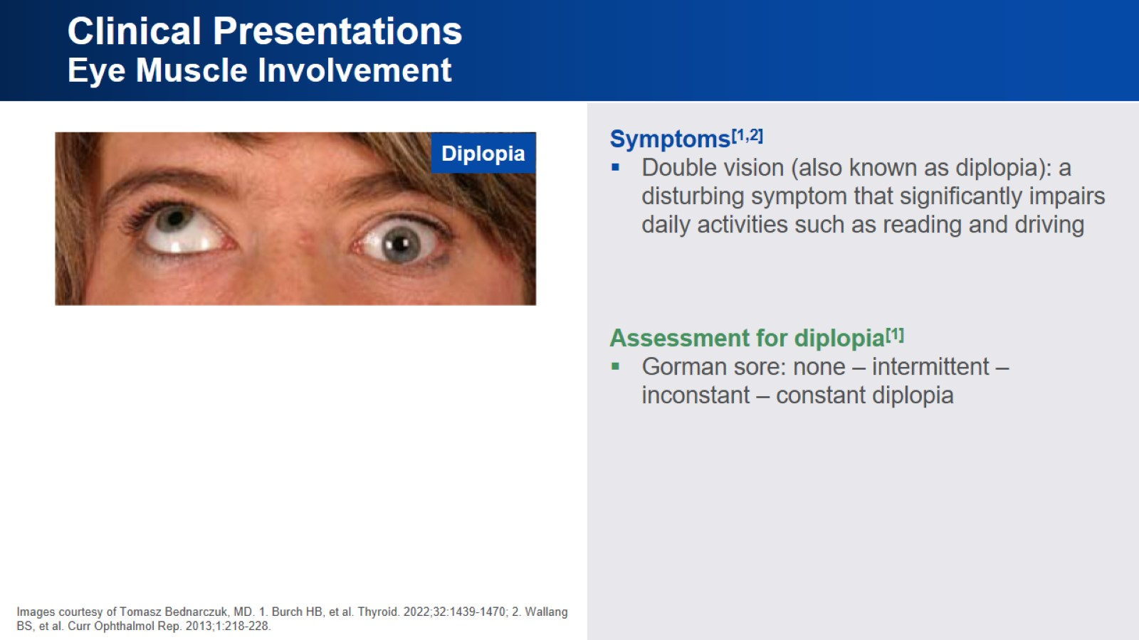
Clinical Presentations
Eye Muscle Involvement

Slide 20
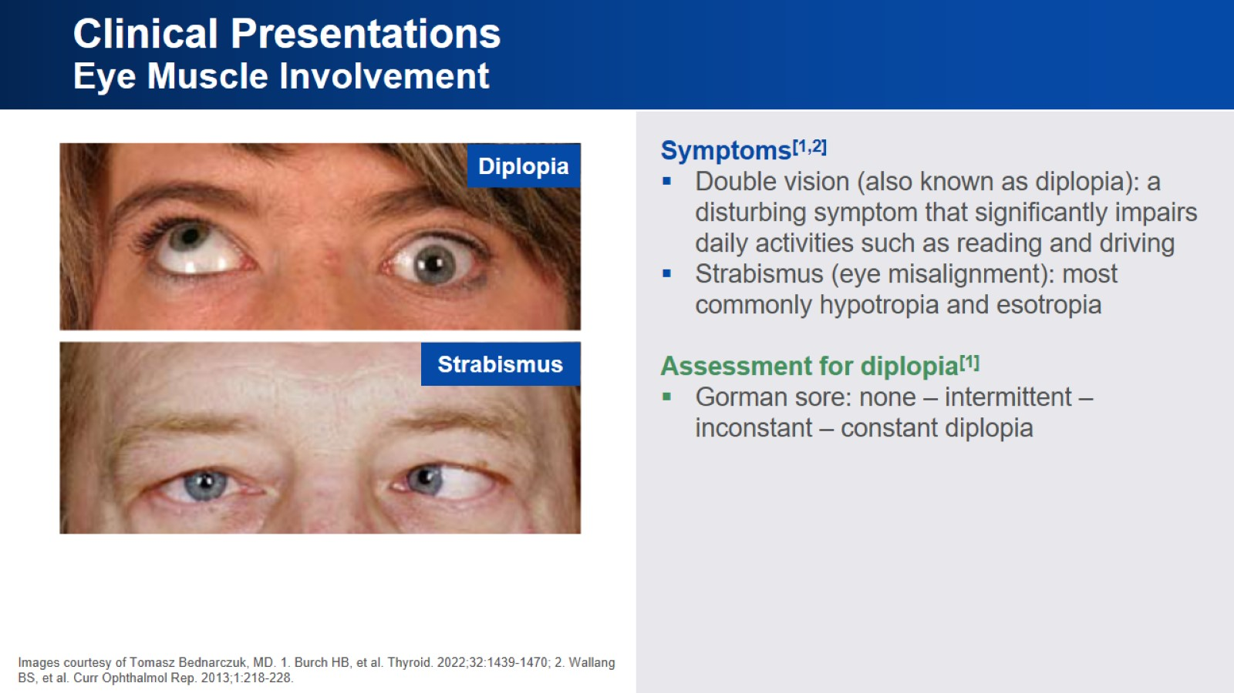
Clinical Presentations
Eye Muscle Involvement

Slide 21
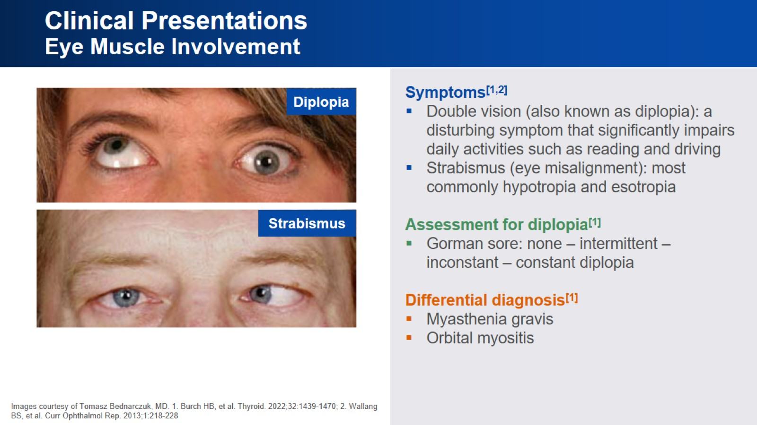
Clinical Presentations
Eye Muscle Involvement

Slide 22
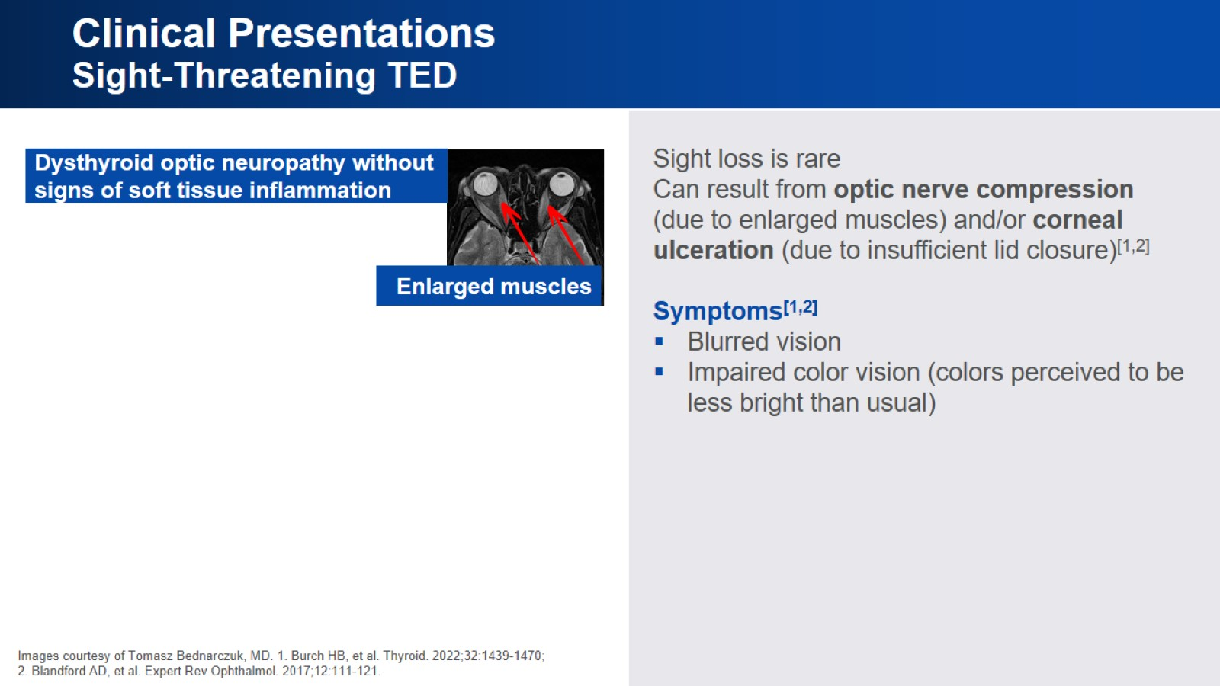
Clinical Presentations
Sight-Threatening TED

Slide 23
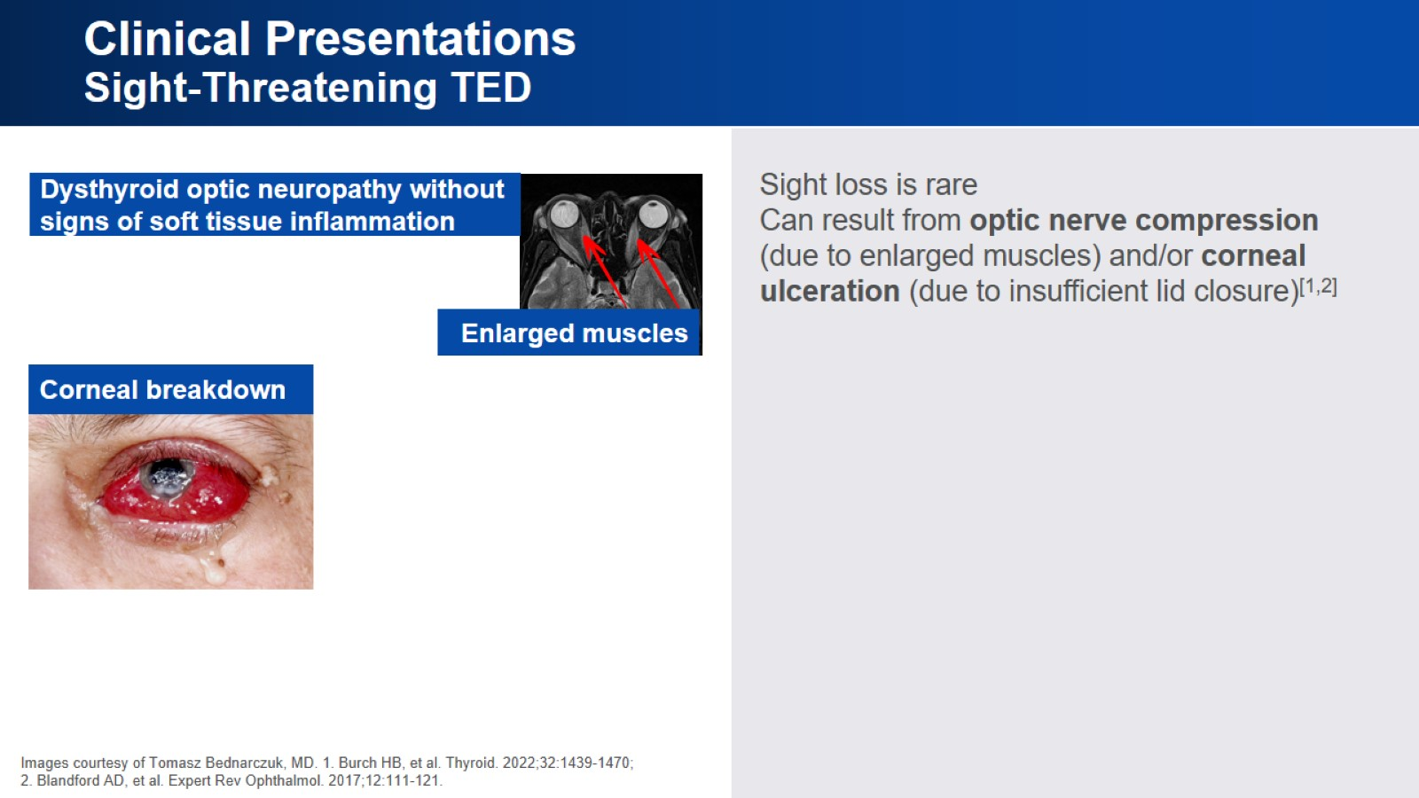
Clinical Presentations
Sight-Threatening TED

Slide 24
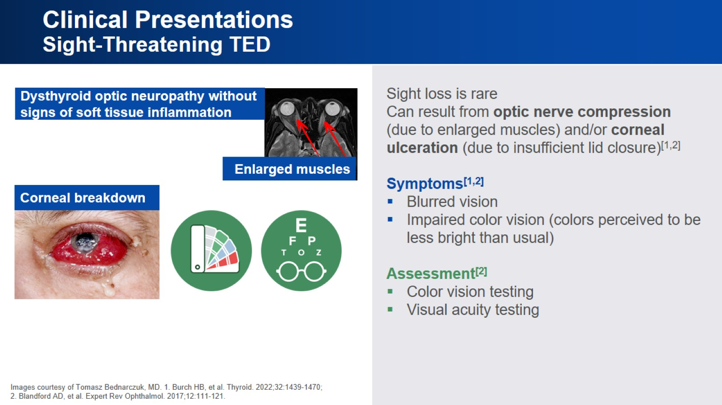
Clinical Presentations
Sight-Threatening TED

Slide 25
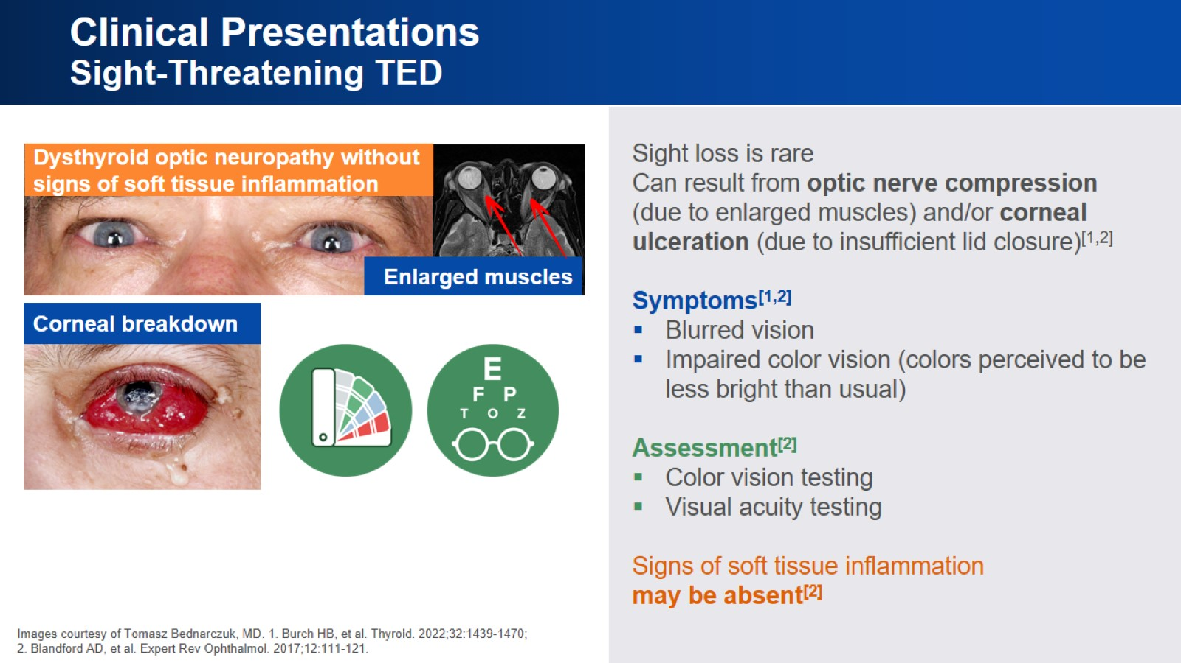
Clinical Presentations
Sight-Threatening TED

Slide 26
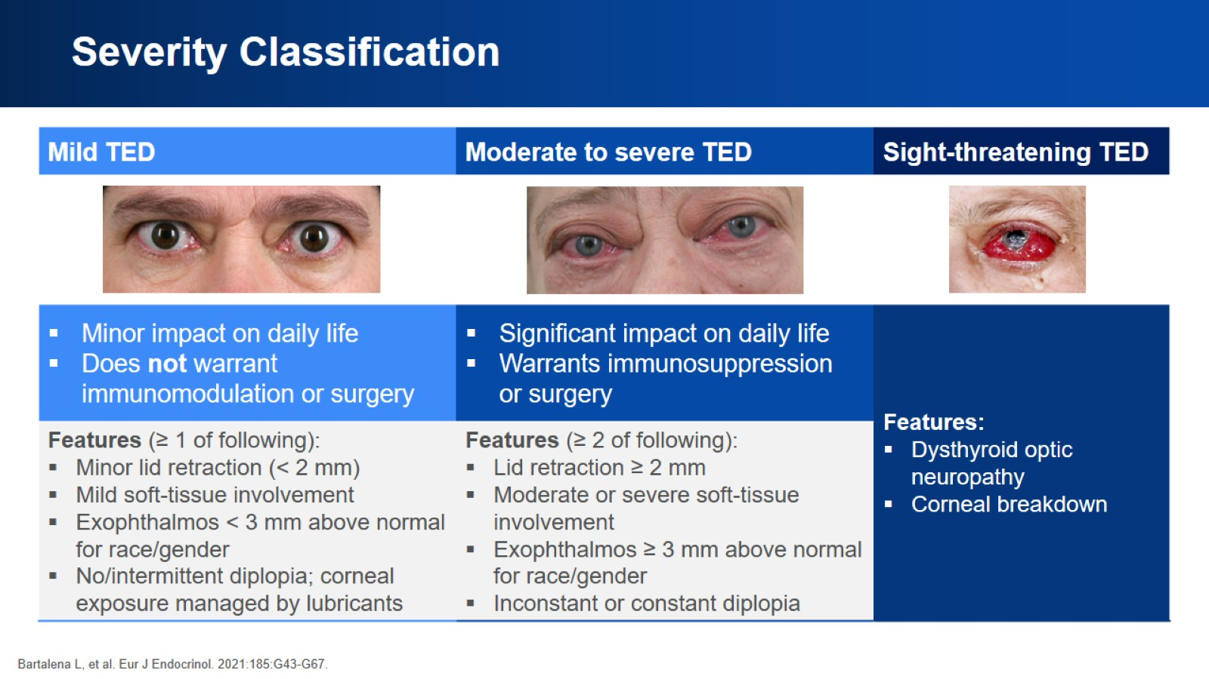
Severity Classification

Slide 27
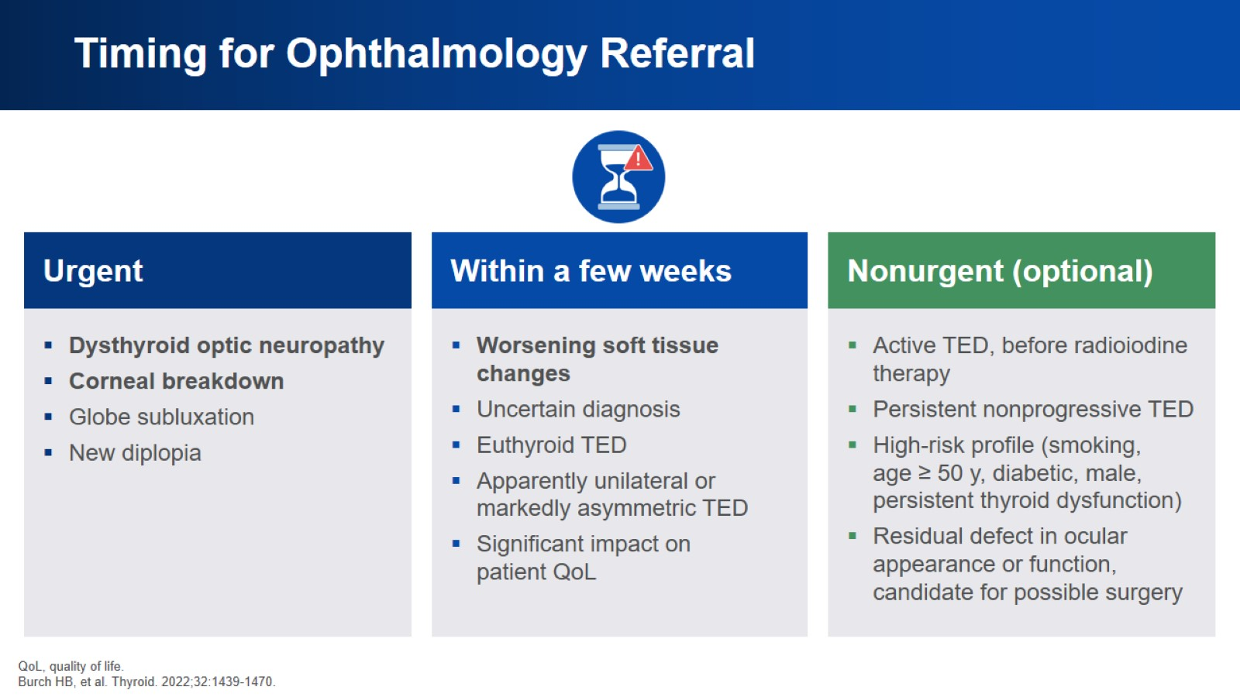
Timing for Ophthalmology Referral

Slide 28
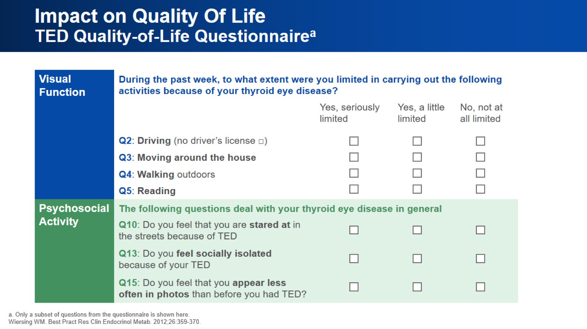
Impact on Quality Of Life
TED Quality-of-Life Questionnaireª

Slide 29
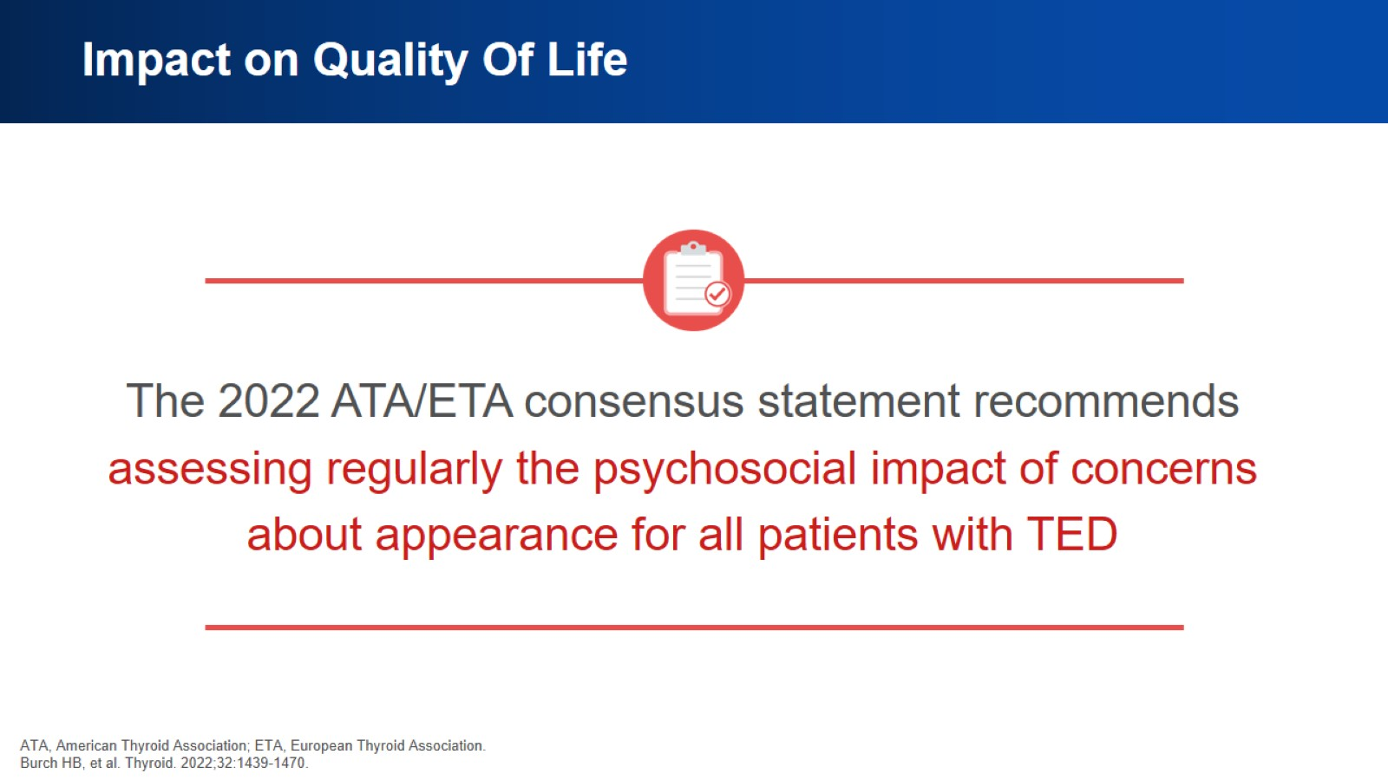
Impact on Quality Of Life

Slide 30
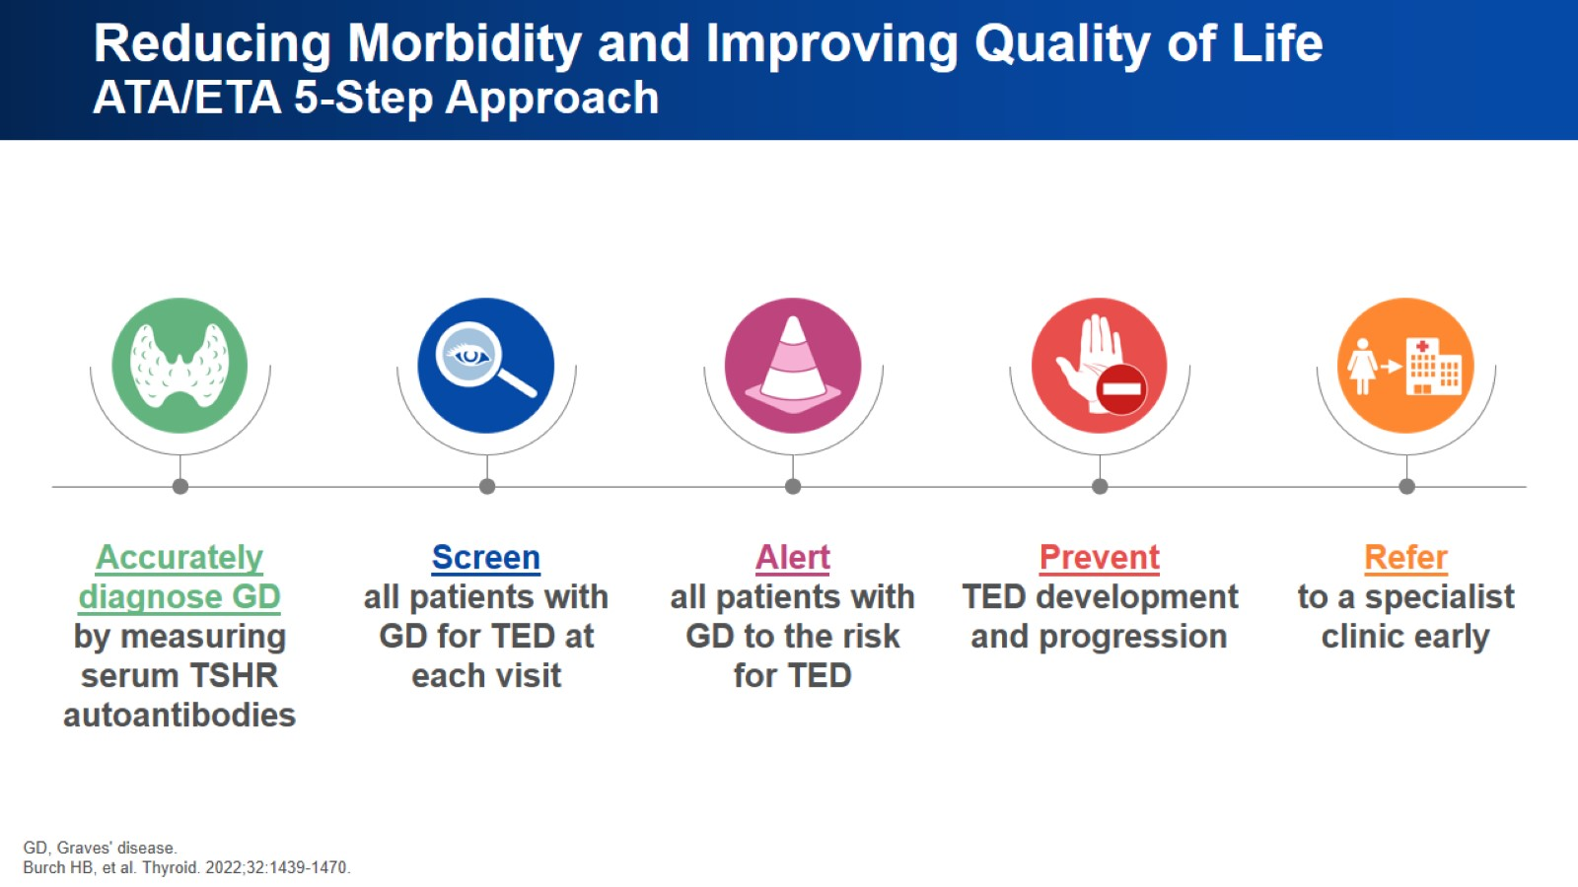
Reducing Morbidity and Improving Quality of Life
ATA/ETA 5-Step Approach

Slide 31
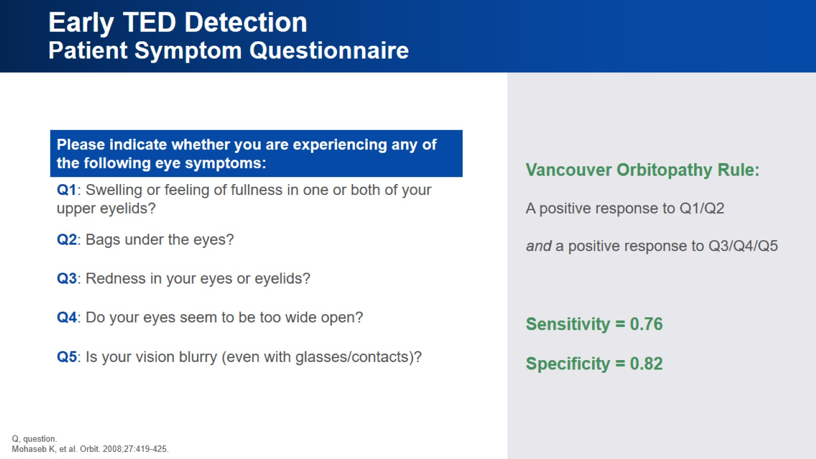
Early TED Detection
Patient Symptom Questionnaire

Slide 32
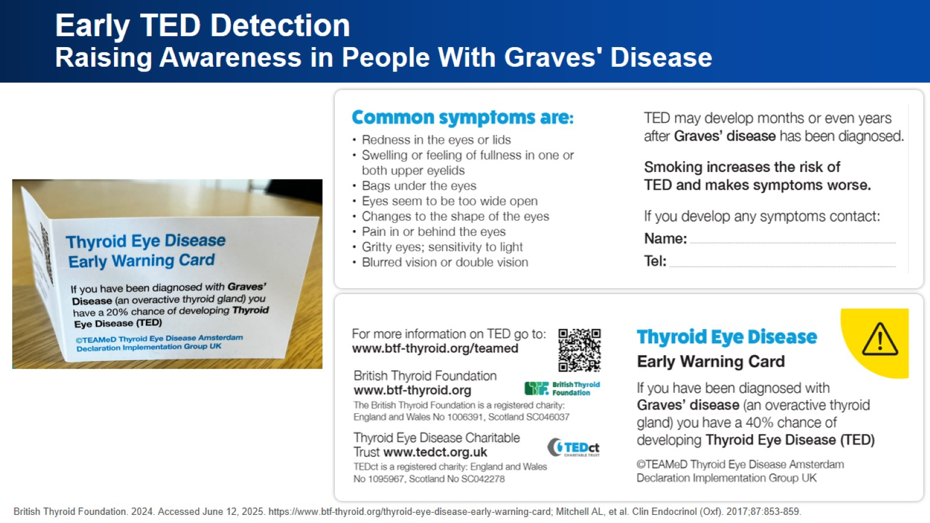
Early TED Detection
Raising Awareness in People With Graves' Disease

Slide 33
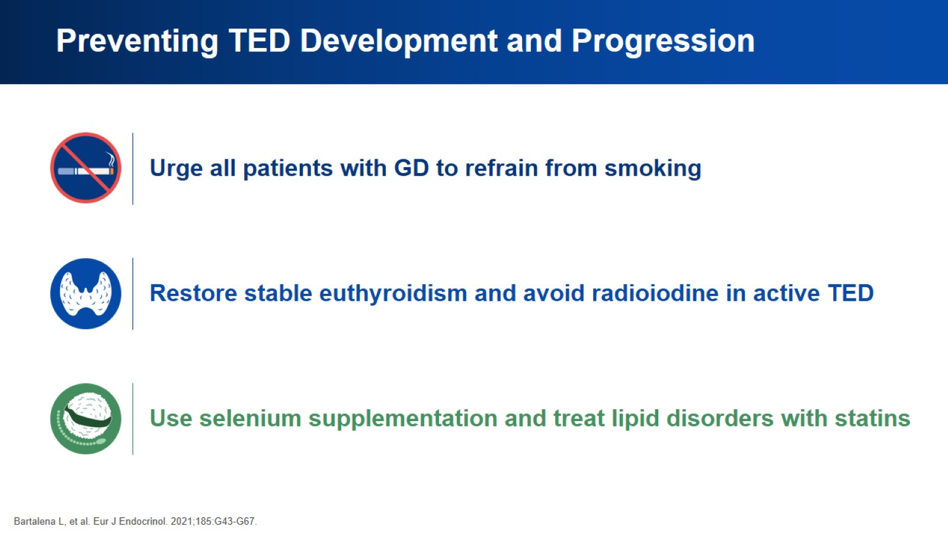
Preventing TED Development and Progression

Slide 34
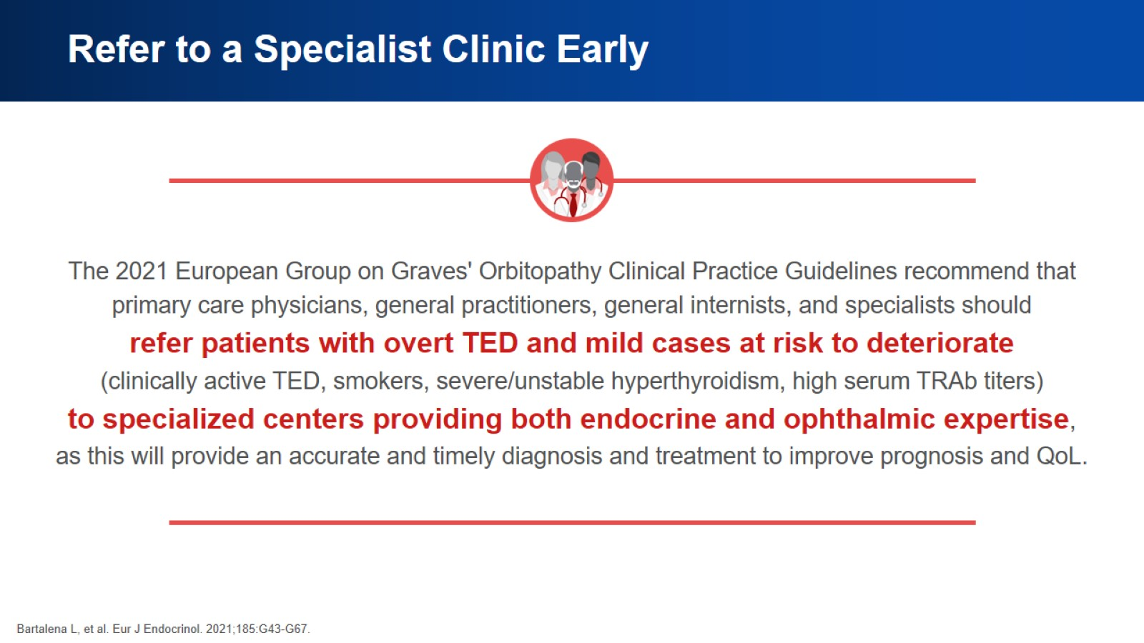
Refer to a Specialist Clinic Early

Slide 35
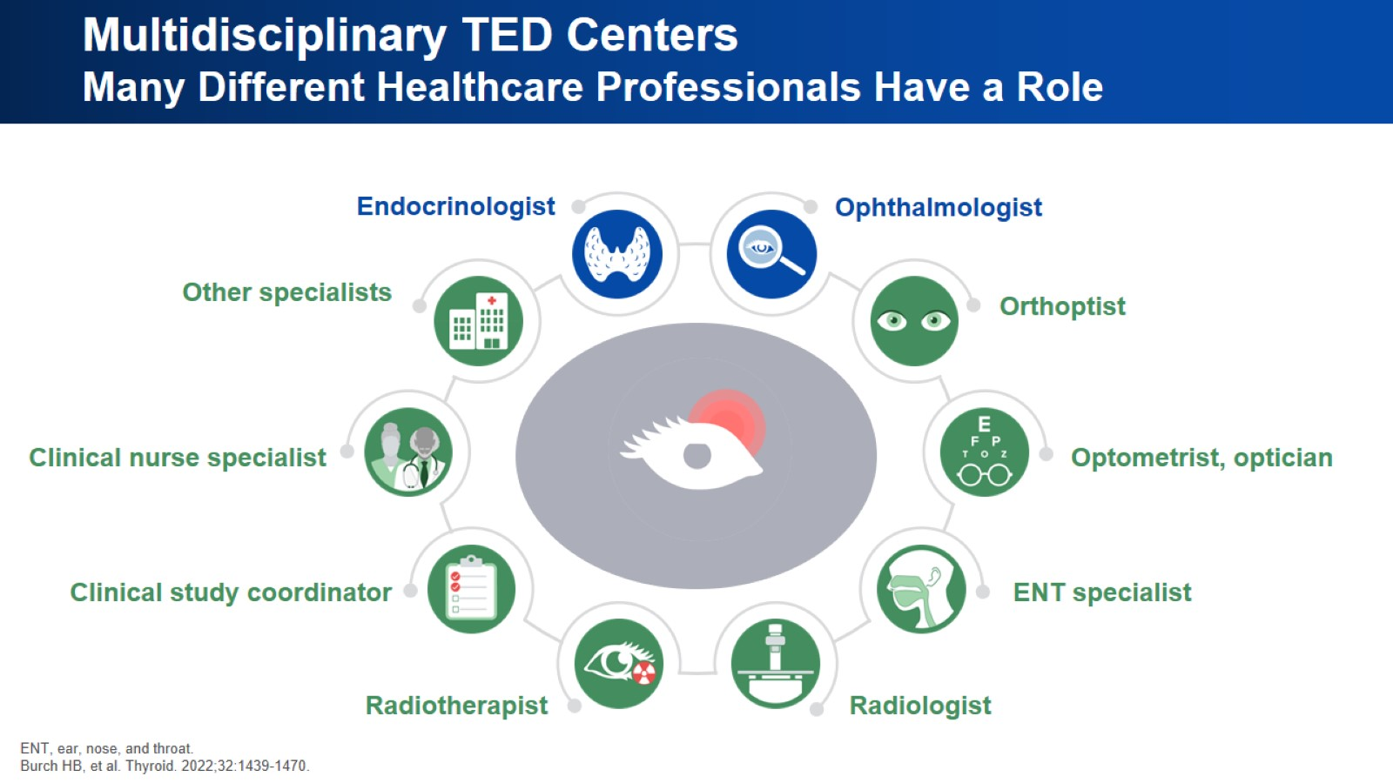
Multidisciplinary TED Centers
Many Different Healthcare Professionals Have a Role

Slide 36
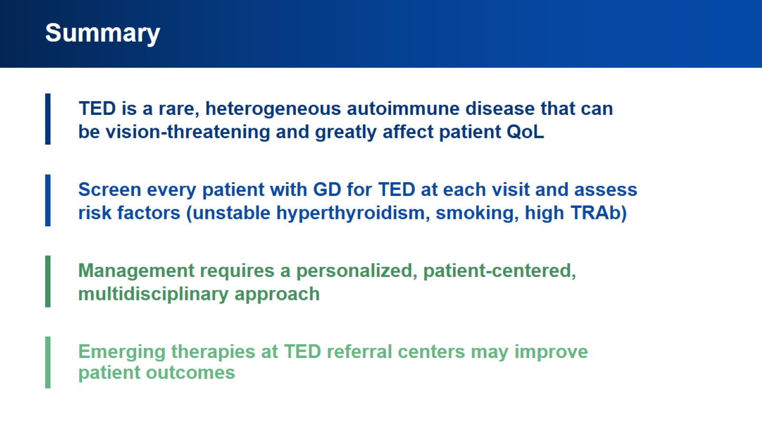
Summary

Slide 37


